Slide 1
CLS Safety Training for High School Students
11.14.1.4 Rev. 4
The purpose of this training module is to provide high school students participating in education programs at CLS with an understanding of the safety considerations related to working in a scientific research facility.

Slide 2
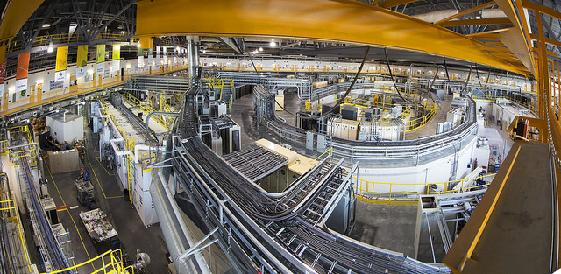
This is the Canadian Light Source synchrotron:
We are excited for you to come and work with us at this national science research facility. Safety is our highest priority. Thank you for taking the necessary training to be safe! ☺

Slide 3
Upon passing this module you will be granted supervised access for the duration of your program.
Your training will remain valid for two years.
You must achieve 80% on the multiple choice test.
Keep the PPT. It’s an open book test.
3

Slide 4
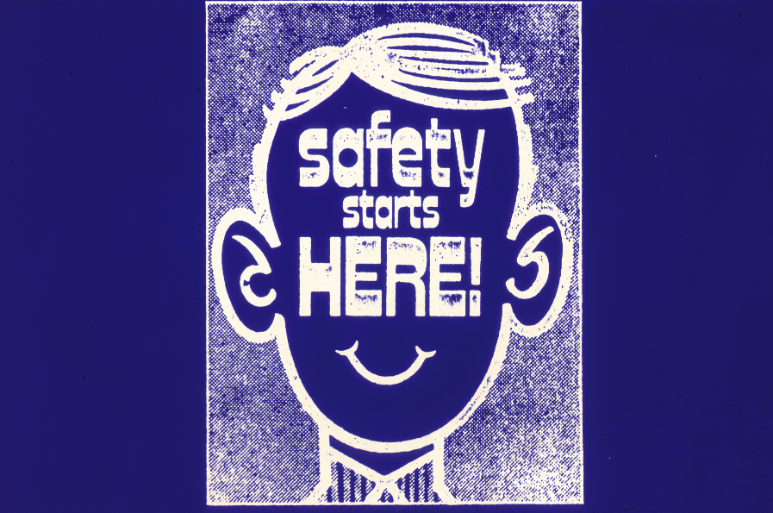
All education projects and programs will have at least one supervisor at CLS with additional training that is responsible for the project and the student(s) involved. Make sure you know who this person is so that you know where to get help.
Report to a supervisor if you ever feel uncomfortable or unsafe doing something, or if you witness something that you feel is unsafe – tell the supervisor responsible for your project.
When it comes to safety, you have the right:
To know
To participate
To refuse
4

Slide 5
Outline
These are the topics this training will cover… but this is not necessarily the order. Several of these topics overlap:
Controlled Areas and Signs
Supervision Requirements
General Safety Hazard Awareness
Alarms and Protocols for Each Hazard
General Good Laboratory Practices
Personal Protective Equipment
5

Slide 6
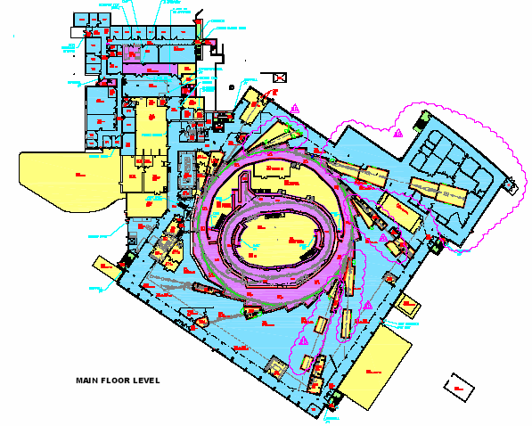
Access Zones – CLS is a secure building
First Floor
Entrance to Controlled Access Zones is granted only when you are escorted by a supervisor with additional training specifically for the restricted area you are entering
This includes the Experimental Hall and may include Radiological or Industrial Controlled areas.
Free Access Zone
Controlled Access Zone
Industrial Controlled Area
Radiological Controlled Area
6

Slide 7
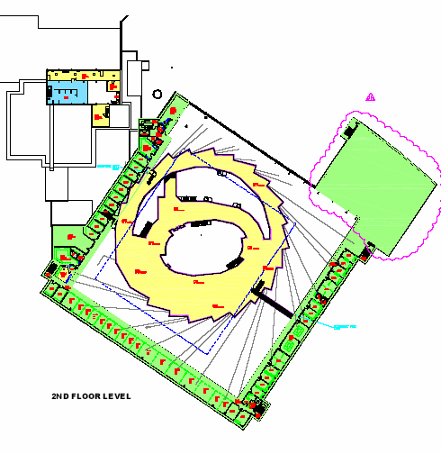
Access Zones
Upon successful completion of this training, you will be granted unsupervised entrance to the Free Access Zone. This includes reception, the second floor mezzanine, and office areas.
Second Floor
Free Access Zone
Controlled Access Zone
Industrial Controlled Area
Radiological Controlled Area
7

Slide 8
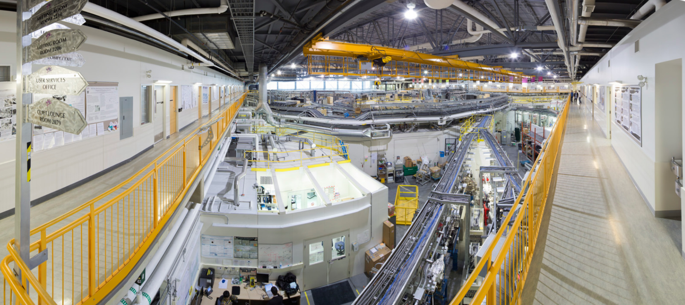
Free Access Zone includes the second floor mezzanine walkway by the offices and meeting rooms pictured here.
You will be allowed unsupervised access here
Controlled Access Zones include the main floor Experimental Hall where beamlines and labs are (the Mezzanine overlooks these controlled areas) as well as other areas of the building shown in the maps on previous slides.
You will need a properly trained supervisor to be here!
8

Slide 9
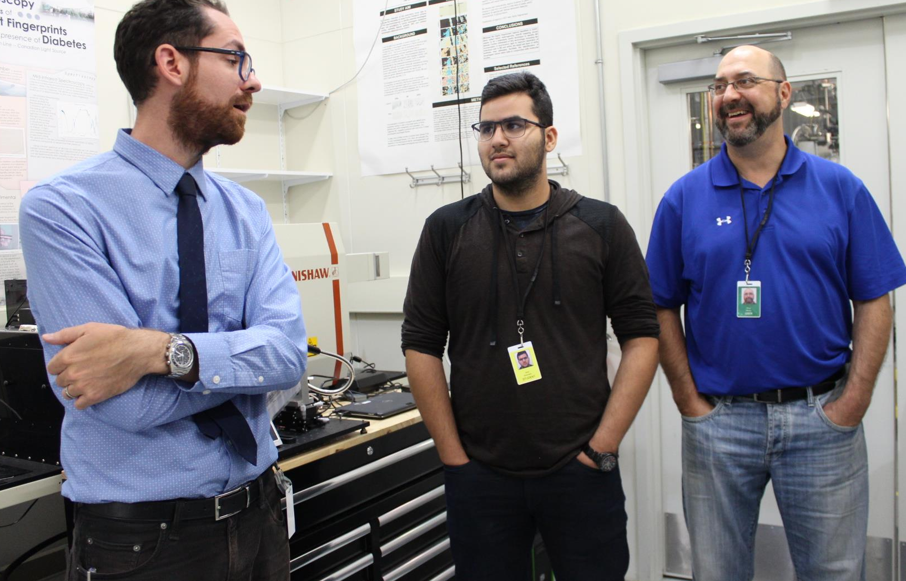
Supervisors
Students are only allowed on the Experimental Floor (or any other Controlled Access Zone) when a fully trained supervisor with an activated access card accompanies them.
A supervisor can be:
CLS personnel
A teacher or other adult designated as a supervisor by the school with training
Other adult associated with the program (such as a mentor) with training
Teacher wearing a green user id badge
Student wearing a yellow id badge
CLS staff wearing a purple id badge (on his hip)
Students must be escorted at all times by a fully trained supervisor to enter any controlled access zone.
9

Slide 10
Role of Supervisors
When there is a group of students at the facility accompanied by supervisors designated by their school, there must also be a CLS staff person associated with their project or program.
The role of a supervisor designated by the school is to:
Prevent student participation in any activity they feel is unsafe
Care specifically for the well-being of the students (food, water, emotions, etc)
The role of CLS staff is to:
Enable the safe conduct of the experiment or other facility-related activity
Care specifically for the safety of people (including students and school supervisors) and of equipment
Ensure all CLS policies are followed
10

Slide 11
Role of the Student
Report security incidents to your supervisor immediately.
Notify a supervisor immediately, if there is an accident, injury or emergency – or if there is potential for one.
You may feel a bit uncomfortable questioning a staff member or supervisor about safety, but remember … everyone, including students, is responsible for their own safety and asking questions is a good thing! ☺

Slide 12
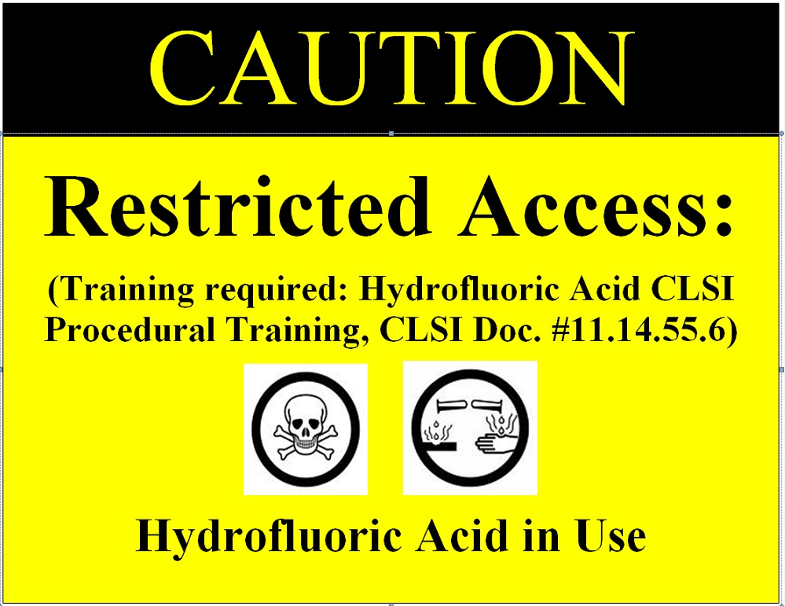
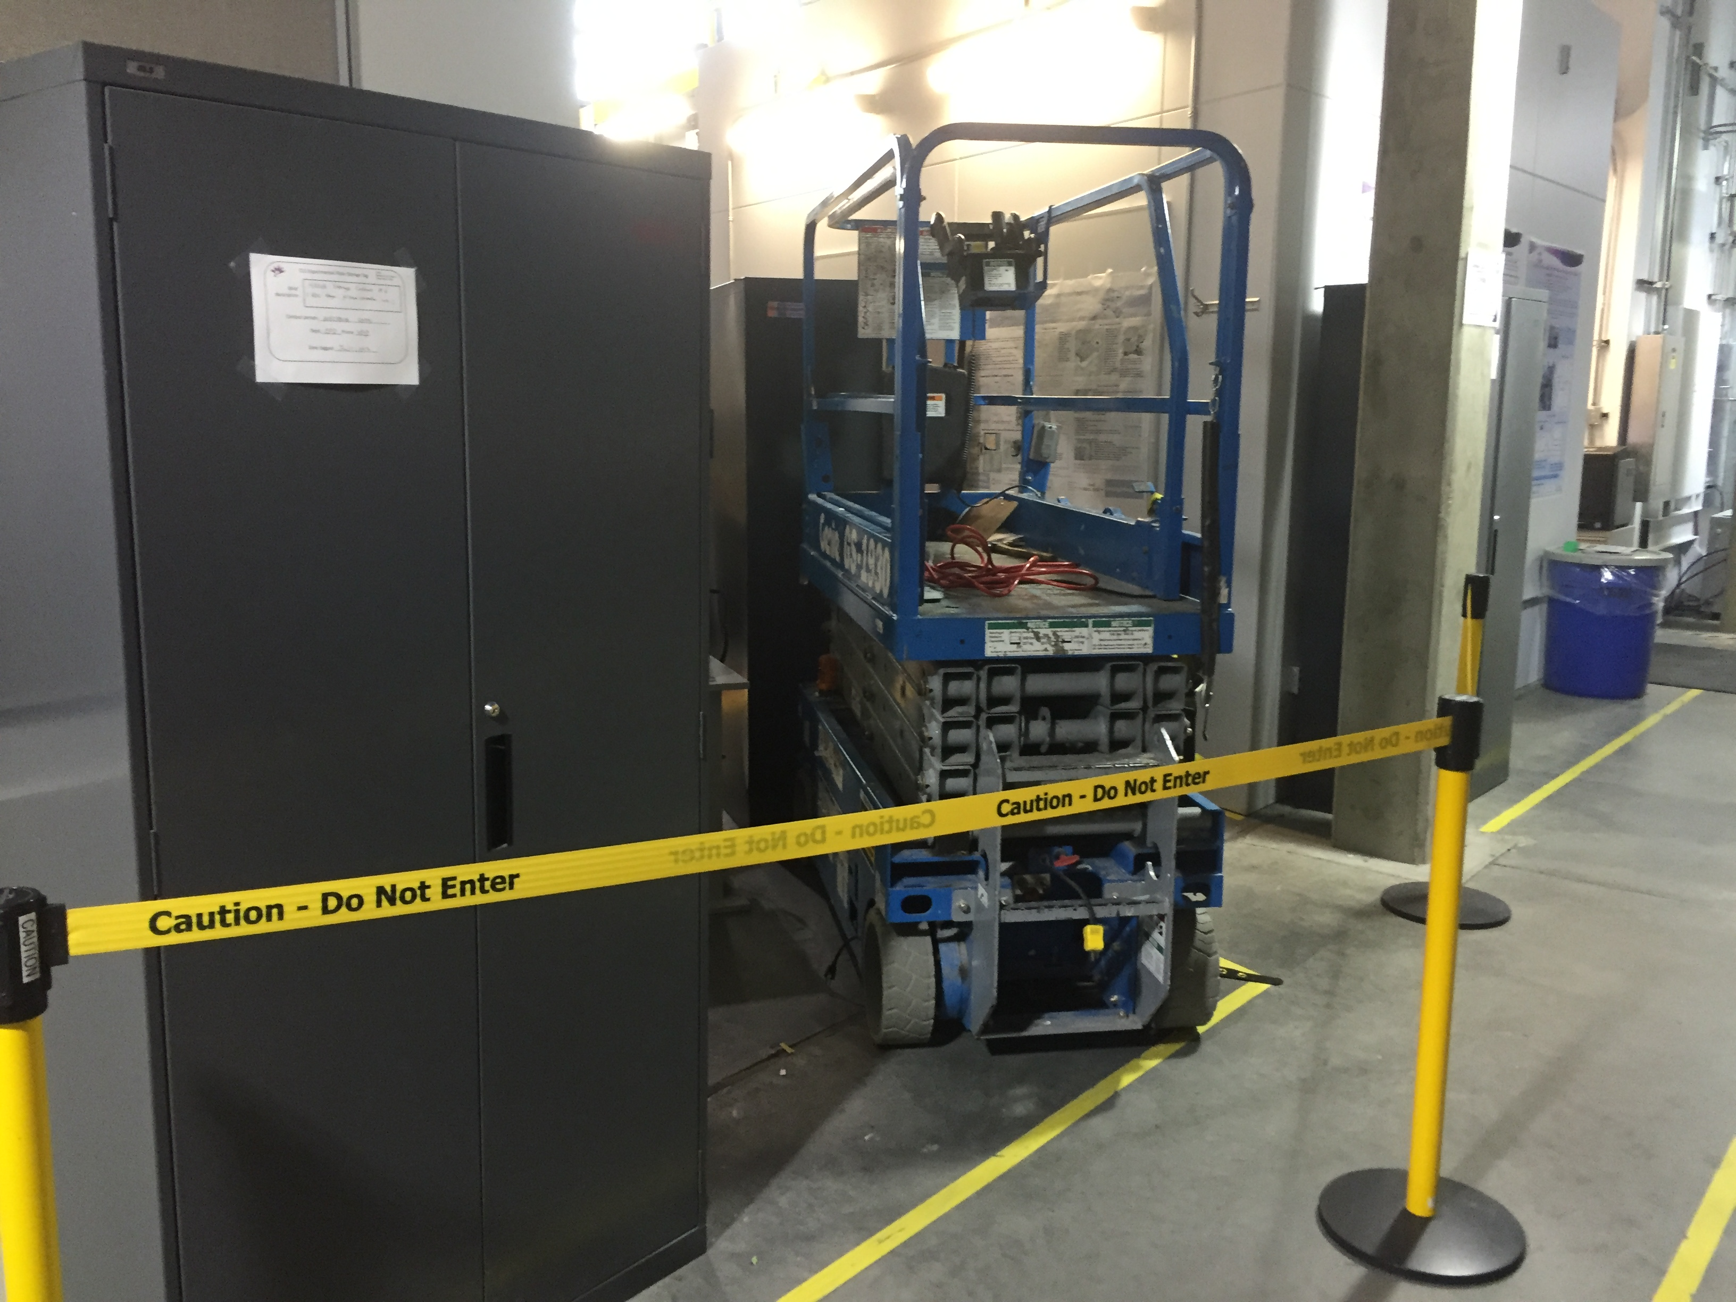
CLS Signage
Signs are posted to communicate restricted areas and information about related safety requirements.
You must respect all signs!
Respect all Restricted Area signs and never adjust or remove them! Only a properly trained supervisor can escort you into that area, and only if you need to be there.
12

Slide 13

Building Evacuation
All personnel must leave the building when the fire alarm sounds and white lights flash intermittently.
double click the icon to listen to the alarm
Leave the building through the nearest exit and assemble on the grass near the CLS sign, by the road. (see map and photo next slide).
Find one of your supervisors as quickly as you can
If you cannot find a supervisor, ask for help from any CLS employee
Remain at the assembly area until your supervisors give instructions.
13

Slide 14
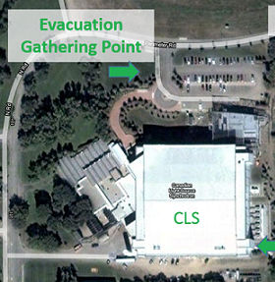
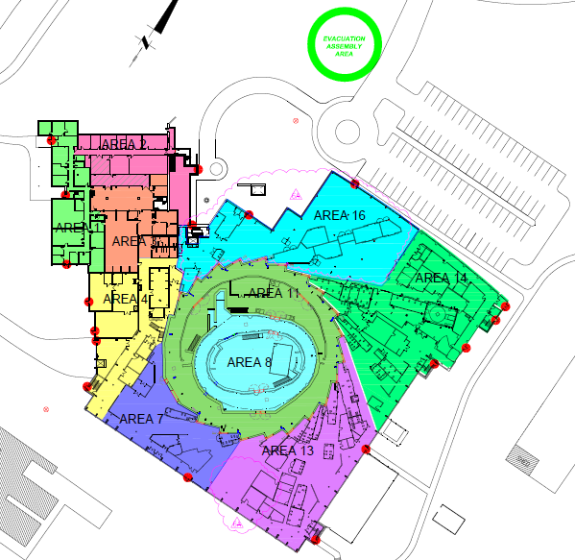
Building Evacuation Meeting Place: on the lawn by the CLS sign
Meeting Area
Emergency exits are located in stairwells in the corners of the building – fire alarm pull stations are located near the exits.
Red dots are emergency exits
14

Slide 15
Hazards
Hazards may include:
Physical such as Noise or Heights
Cryogenic
Electrical/Mechanical
Magnetic
Radiological (ionizing and non-ionizing)
Chemical/Biological
Areas where there are hazards are made safe for workers through controls like restricting access, additional training, and protective equipment.
Be sure you are able to recognize hazards and avoid them when possible. Follow all instructions from your supervisors when working near a hazard.
Controls must not be tampered with!!
Listen for alarms and watch for signs.
15

Slide 16
Physical Hazards
Physical hazards at CLS include the following:
Heights
Working at certain heights requires you to be tied off. You will likely not be asked to work in these areas.
Noise
The noise in mechanical rooms or around
equipment can exceed the federal sound
level guidelines. The sound levels are
monitored and signs are posted as required.
Earplugs are mandatory where signs are posted,
and always available.
Use them in other areas if you need them.
16

Slide 17
Physical Hazards
Forklift, Scissor Lift, etc.
These types of vehicles traveling through the facility can be hazardous for people walking since the load being carried could restrict the vision of the operator.
Look around for the hazard and keep clear of the area. Listen for the backup beep.
Overhead Crane
The crane moving back and forth could be carrying loads and creating a hazard overhead.
Look up and around for the hazard and keep clear of the area. Listen for the horn. Do not cross the retractable belt barriers.
Click the horn icons to hear examples of the alarms
17

Slide 18

Physical Hazards
Vacuum/Compressed Air
The beam pipe and other equipment are under a high vacuum. An implosion of a vacuum system can generate small flying objects.
There are compressed air lines throughout the building.
Do not touch these unless you have specific instructions to do so.
Machine Shop
Moving parts on equipment, welding, grinding and cutting are some of the hazards found in machine shops. Additional, specific, training is required to enter these areas.
Do not touch equipment unless you have specific instructions to do so.
18

Slide 19
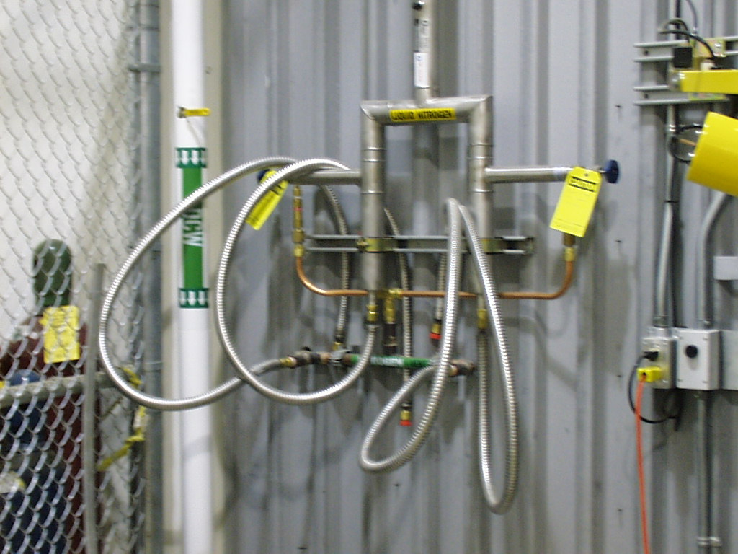
Cryogenic Hazards
Liquid helium and liquid nitrogen are stored in the cryogenics room. Additional, specific training is required to enter this room.
Cryogens are also distributed to various places around the facility for use. These areas are clearly marked and only to be used by those with appropriate training.
These liquids are extremely cold and can cause severe frost-bite if you come into contact with them.
They also have a high expansion ratio (1:700) and can reduce the oxygen concentration in the air, creating an oxygen deficient atmosphere.
19

Slide 20
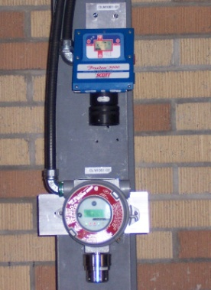
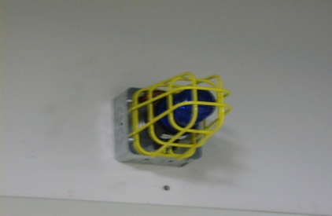
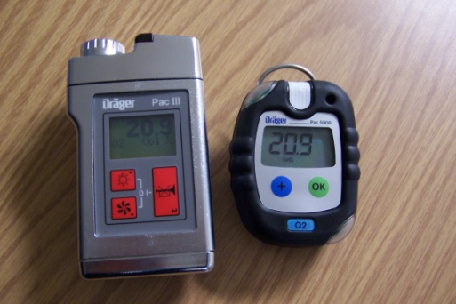

Cryogenic Hazards
Oxygen Concentration Monitoring
The oxygen concentration is monitored in areas where an oxygen deficient atmosphere could develop.
Emergency procedures :
If the BLUE warning lights and buzzer activates:
Leave the area immediately, to a minimum distance of 10 meters
Warn anyone in the area
Find and report to your supervisor(s)
Click for Alarm sound
Oxygen Sensors
Oxygen Warning Light
Portable Oxygen Monitors
20

Slide 21
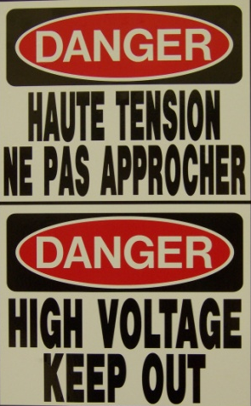
Electrical/Magnetic Hazards
Electrical Fields
The CLS uses high voltage and current to operate various power supplies.
Keep clear of these areas unless you have specific instructions to be there.
Magnetic Fields
Exposure to magnetic fields of extremely low frequency may present a health risk.
If you have conditions that might be affected (such as a pace-maker) please discuss this with your supervisors before visiting CLS.
21

Slide 22
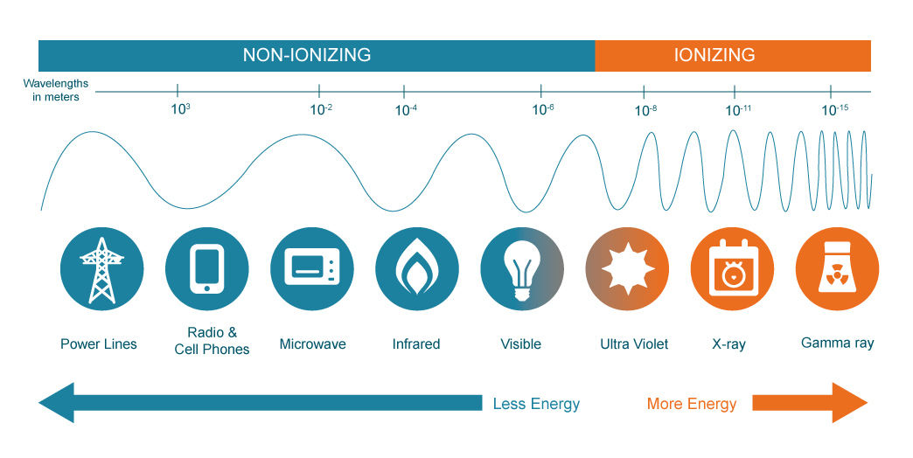
Radiological Hazards: Background
What is radiation?
Radiation is energy transferred through space and matter.
There are two different types of radiation:
Non-ionizing radiation (radio waves, visible light, microwaves) does not have enough energy to remove electrons from atoms.
Ionizing radiation (x-ray, gammas) has enough energy to remove electrons.
When ionizing radiation travels through a medium it deposits (loses) some of its energy to the medium. If the energy is deposited in a person, he or she receives a radiation dose.
https://www.mirion.com/introduction-to-radiation-safety/what-is-radiation/
22

Slide 23
Radiological Hazards: Background
Humans are constantly exposed to ionizing radiation from natural sources, regardless of where they are on the earth, even inside CLS’ shielding.
Natural sources include:
cosmic rays
radioactive elements in the earth
ingestion of radionuclides in food
inhalation of radon gas
The average annual radiation dose to the general population in Canada from natural sources is about 2 mSv (milli-Sieverts) per person.
24

Slide 24
Radiological Hazards: Background
Human-made Sources include:
Medical: X-rays, nuclear medicine imaging or radiation treatments
Consumer products: Smoke detectors, gas lantern mantles
Fallout from nuclear weapons testing or nuclear reactors for power generation
The average annual radiation dose to the general population in Canada from human-made sources is about 0.6 mSv per person
**NEW = Nuclear Energy Worker
24

Slide 25
Radiological Hazards: Background
Industry Type or Activity | Estimated Days of Life Expectancy Lost*
Smoking 20 cigarettes a day | 2370 (6.5 years)
Overweight by 20% | 985 (2.7 years)
Mining and Quarrying | 328
Construction | 302
Agriculture | 277
Government | 55
Manufacturing | 43
Radiation – 3.4 mSv/yr for 30 years | 49
Radiation - 1 mSv/yr for 70 years | 34
*based on the latest report from the National Academy of Sciences' Biological Effects of Ionizing Radiation (BEIR) series - BEIR V
Notes:
Acceptance of a risk is a highly personal matter. It requires a good deal of informed judgment. The risks associated with occupational radiation doses are considered acceptable as compared to other occupational risks by virtually all the scientific groups who have studied them. The following chart may help you put the potential risk of radiation into perspective when compared to other occupations and daily activities.
The Table above gives Estimated Days of Life Expectancy Lost From Various Risk Factors.
Note: The "life expectancy lost" value is determined from data on percentage of deaths due to the risk factor weighted by the average age at death. Since radiation related deaths are calculated values, they are based on the assumption of cancer as the cause of death, with the associated average age of death from cancer victims. All radiation risk values are based on the latest report from the National Academy of Sciences' Biological Effects of Ionizing Radiation (BEIR) series - BEIR V.

Slide 26
Radiological Hazards at CLS
CLSI requires a license to operate from the Canadian Nuclear Safety Commission (CNSC) because radiation producing devices such as electron beam accelerators and radioactive materials are used at the CLS.
What is the radiological hazard at CLS?
CLS produces low and high energy x-rays to be used in experimental hutches for research.
Secondary radiation may be caused in the rings by the beam striking a target, hardware, or shielding that surrounds the beam pipe causing them to become activated during operations.
People are protected from these sources of radiation by various safety systems.
Students may only access these areas (hutches or rings) when the beam is off, safety mitigations are in place, and there is an appropriately trained supervisor.
26

Slide 27
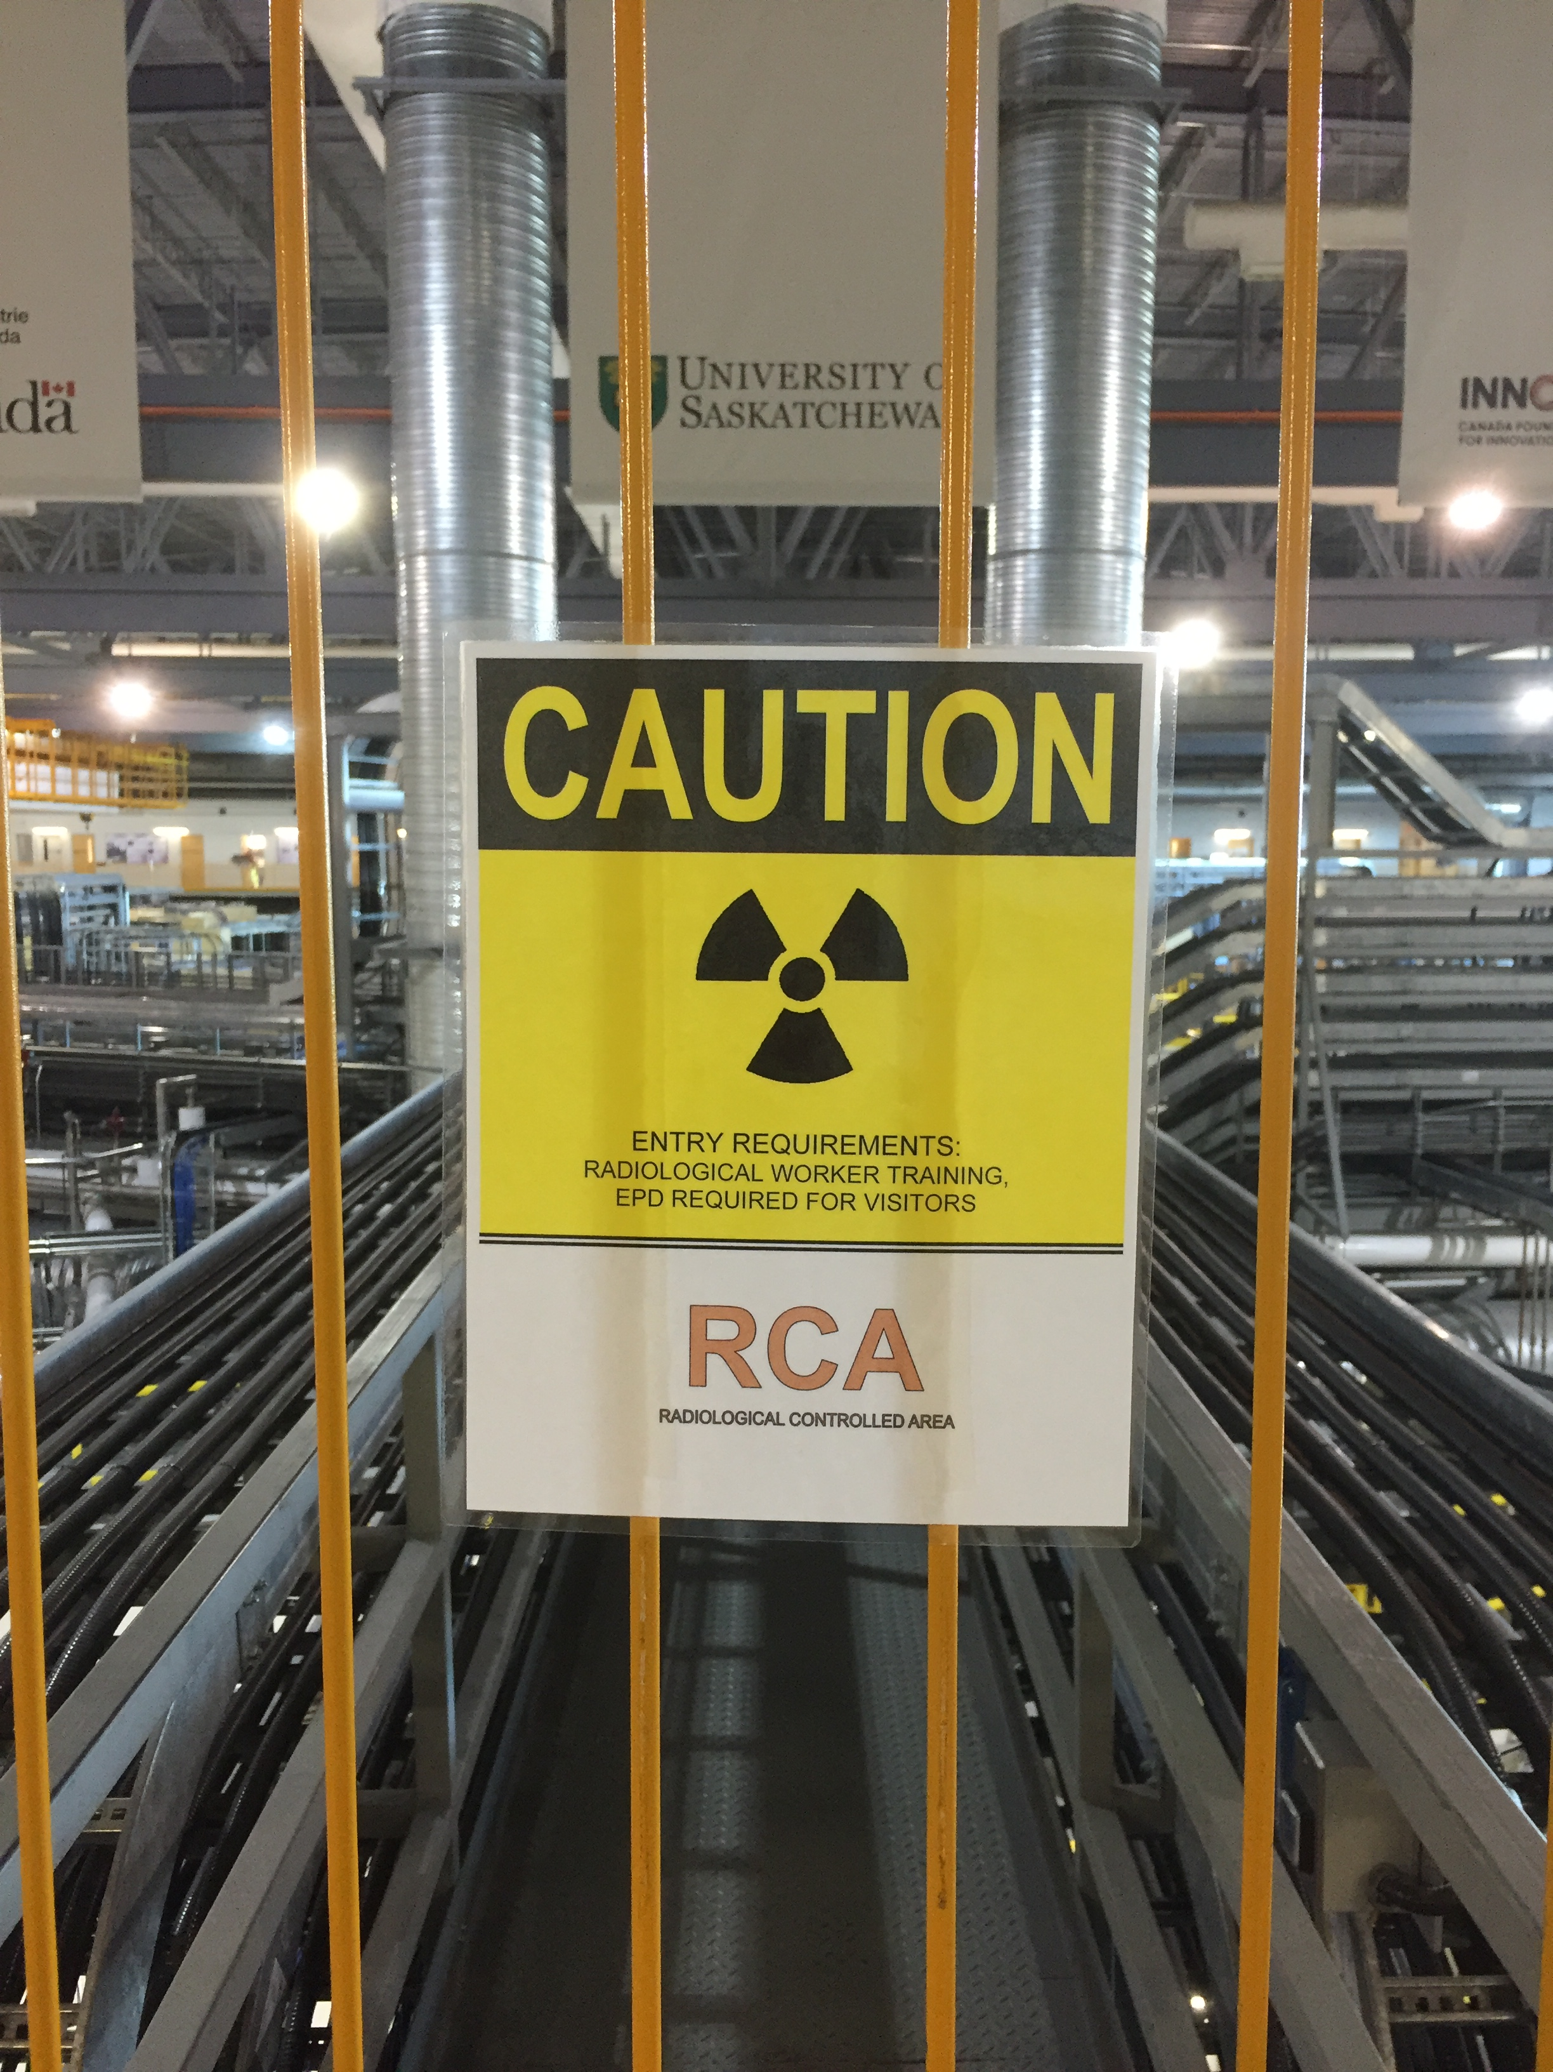
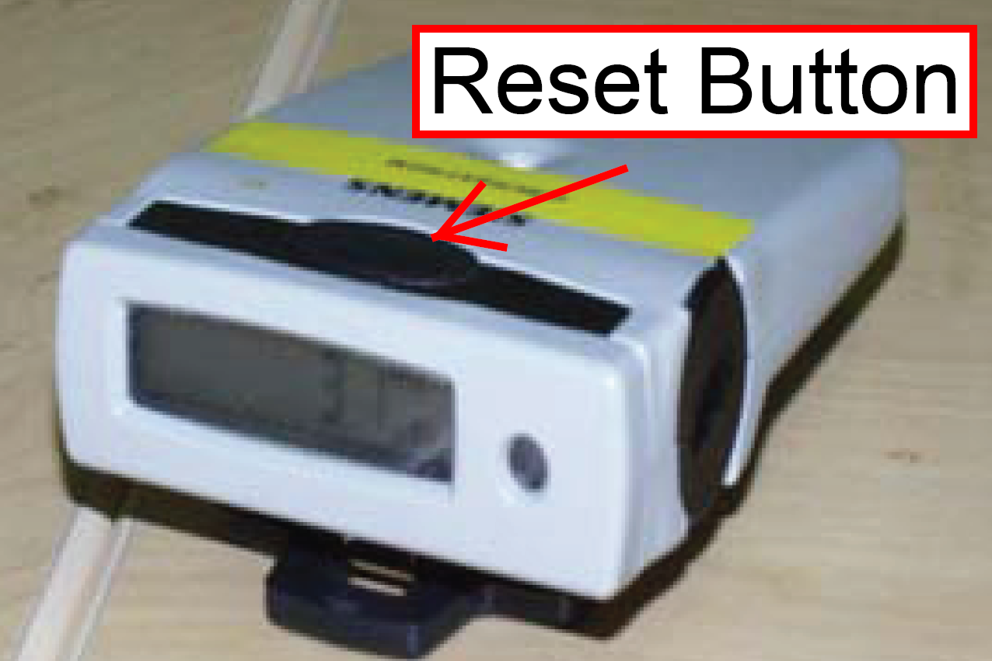
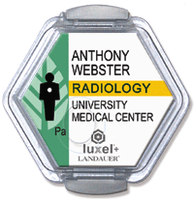
Radiological Hazards: Monitoring
CLSI follows the ALARA Principle:
Keep hazards As Low As Reasonably Achievable.
CLS has personal and area monitoring programs.
One student in the group will wear an Electronic Personal Dosimeter (EPD) that will alarm if 10 µSv/h is detected.
CLS staff and other trained adults wear passive dosimeters.
27

Slide 28
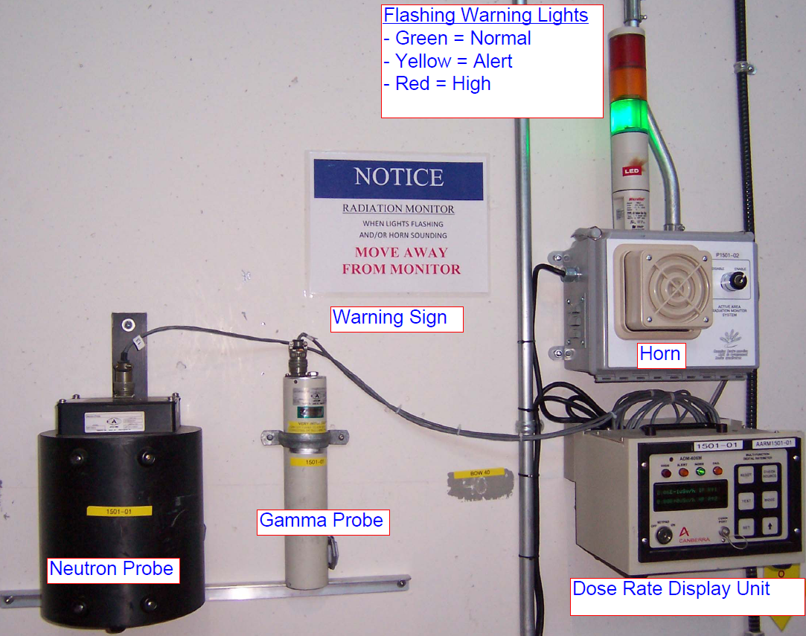
Radiological Hazards: Monitoring
Active Area Radiation Monitoring Stations (AARMS) are located around the facility will alarm to warn of elevated levels.
Alert Radiation Alarm (Yellow light)
> 50 µSv/h
High Radiation Alarm (Red light)
> 100 µSv/h
28

Slide 29
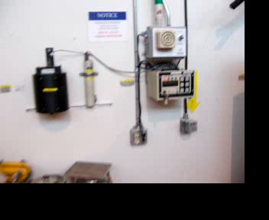
Radiological Hazards: Monitoring
If a radiation monitor alarms,
MOVE AWAY FROM THE MONITOR
Leave the area immediately!
Move at least 10 meters away in any direction and locate a supervisor
Do not return until alarm has been reset
Click on image
to hear the alarm
29

Slide 30
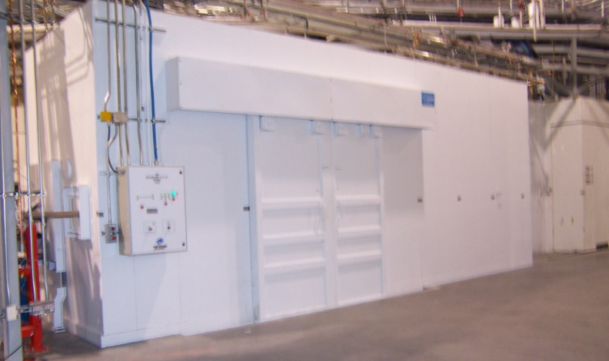
Radiological Hazards: Shielding & Control
Access Control
Visitors & students must be escorted in Controlled Access Zones at all times by trained personnel
Access restrictions protect untrained personnel from unnecessary exposure
Bulk Shielding
Thick cement walls confine most of the radiation produced to the storage ring during operation
Beamline optical enclosures are lined with lead and steel to confine scattered radiation within the hutch
30

Slide 31
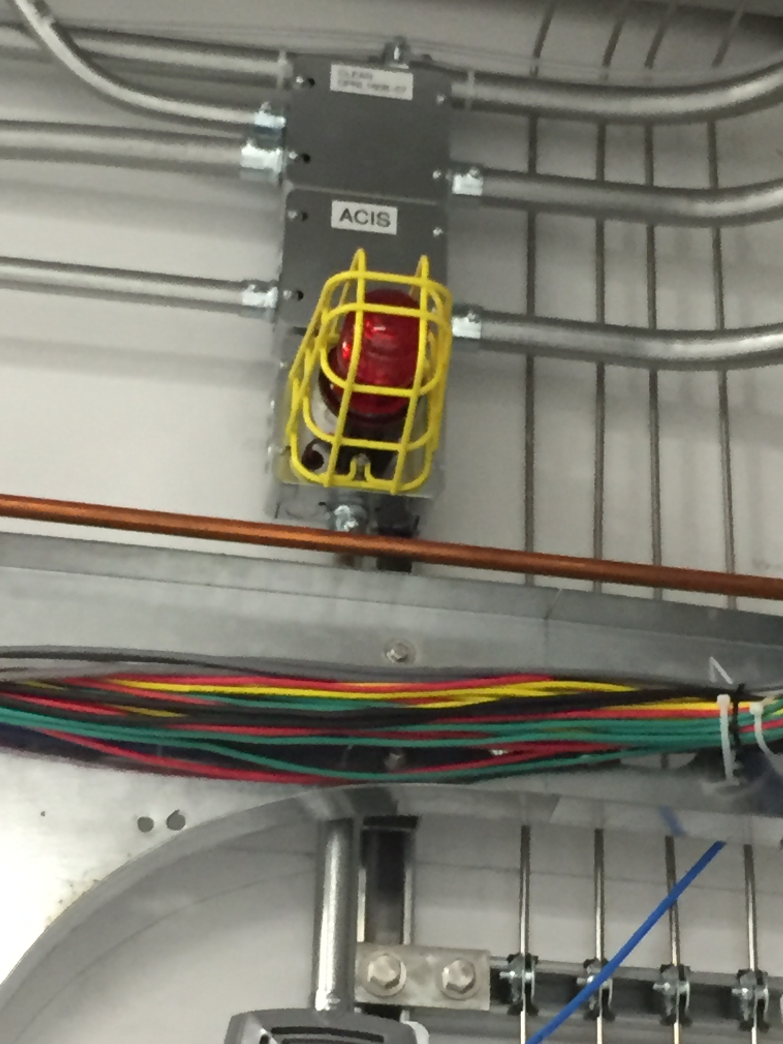
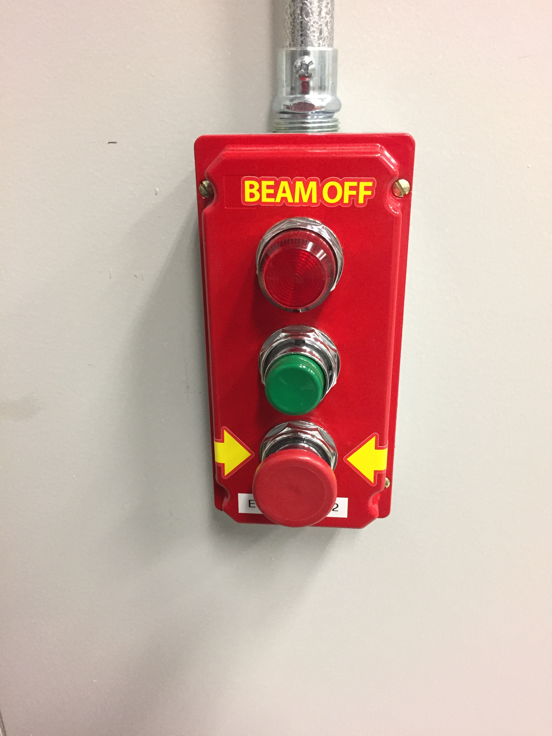
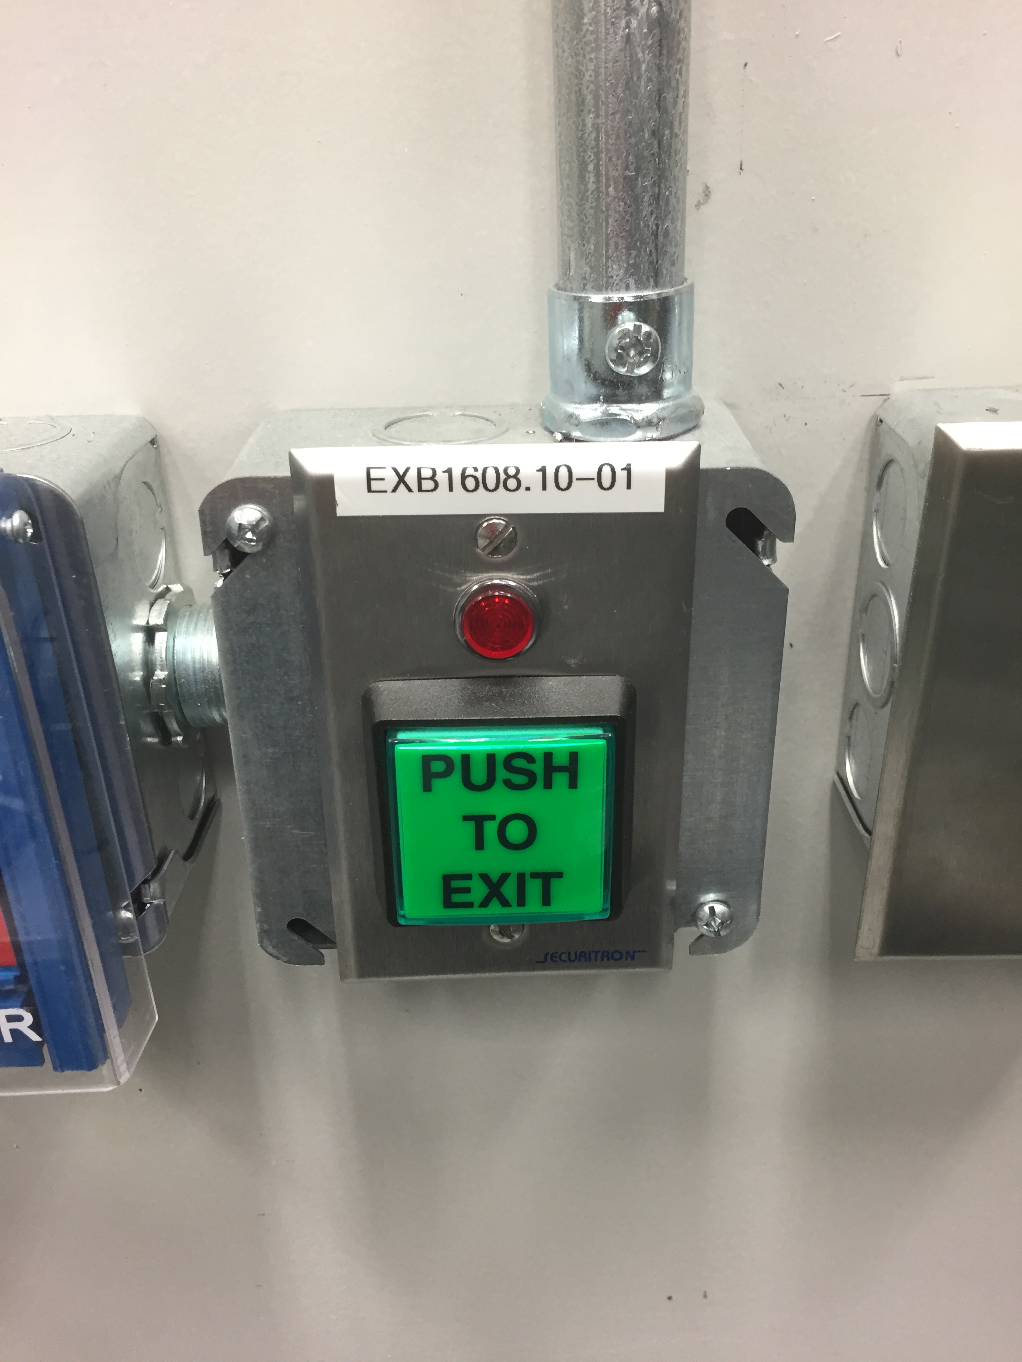
Radiological Hazards: Emergency Exit
You should never be without an escort in a controlled area.
If you are in a beamline hutch or inside the rings and hear a loud buzzer with a red flashing light, that means that someone is locking that area and you need to get out.
2nd
1st
If the door doesn’t open immediately, you may have to push the green exit button beside the door.
Push the big red emergency off button, exit the area and find a supervisor.
31

Slide 32
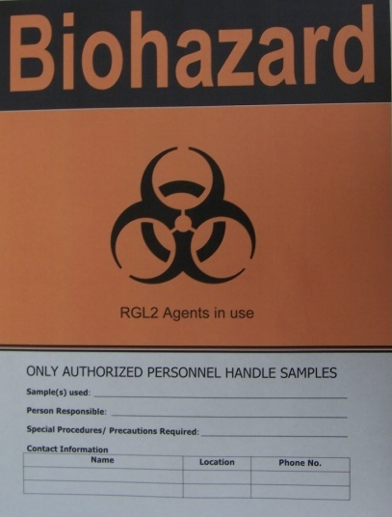
Biological Hazards
A Biohazard is defined as:
Microorganisms/microbes (like viruses), with infectious potential for humans, animals or living entities in the environment.
Materials that may harbor biohazardous materials must also be considered a Biohazard (such as blood or body fluids).
Biohazard signs are posted on entries to areas where biohazardous materials are in use.
Avoid these restricted areas unless you have specific instructions and appropriate supervision.
32

Slide 33
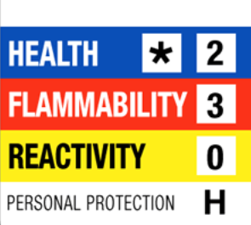
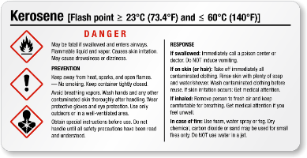
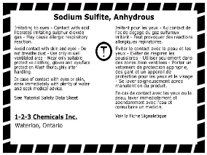

Chemical Hazards – WHMIS Awareness
WHMIS stands for Workplace Hazardous Material Information System.
It is designed to communicate information about hazardous materials.
You need to recognize when you have been given permission to work with something that has been classified as hazardous, wear protective equipment, and follow instructions.
When you see a controlled WHMIS label (examples are shown), know that those items are hazardous and do not touch unless you have specific instructions from your supervisors to do so and are wearing personal protective equipment.
If you see a spill or incident, tell a supervisor immediately!
33

Slide 34
Chemical Hazards – WHMIS Awareness
There are two major Hazard Groups:
Physical – hazardous product presents a physical hazard i.e. likely to burn/support fire, may explode or release high pressure or can spontaneously react on its own or when exposed to water. If you would like to read further about physical hazards click here
Health – hazardous product presents a health hazard i.e. acute (short-term exposure) or chronic (long-term exposure) health effects. If you would like to read further about health hazards click here

Slide 35
Chemical Hazards – WHMIS Awareness
Physical Hazard Pictograms
Health Hazard Pictograms

Slide 36
Sample Handling
Students may handle samples and materials related to their experiment or program when:
Appropriate supervisor(s) are present and providing instructions
If you are wearing appropriate personal protective equipment (identified in later slides)
In designated areas only:
Sample preparation using non-hazardous materials may be performed in designated beamline areas.
Sample preparation involving any hazardous or messy materials must be performed in designated laboratories only with supervision.
At no time is sample preparation, storage or clean up allowed in any other areas (User lounge, lunchroom, bathrooms, etc.)
36

Slide 37

General Operational Laboratory Practices
Do not eat or drink in the lab (including chewing gum and throat lozenges)
Do not store food, personal belongings, or utensils in the lab
Do not apply cosmetics (including lip balm) or insert or remove contact lenses in the lab
Wearing contact lenses is not recommended
37

Slide 38
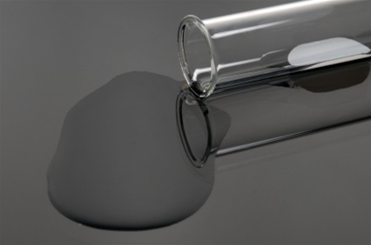
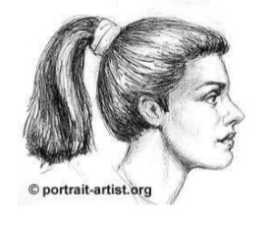
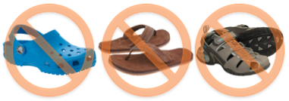
General Operational Laboratory Practices
Lab area must be kept clean and neat
If you see any spill or incident in a lab, report it to a supervisor immediately!
Tie long hair back so that it cannot come in contact with hands, specimens, containers or equipment
Long pants and closed shoes must be worn while in the lab area (no skin should be exposed!!)
38

Slide 39
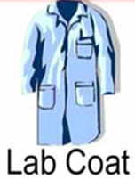

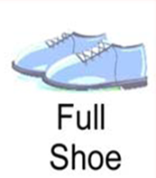
Personal Protective Equipment (PPE)
Cover any open wounds, cuts, scratches or grazes with waterproof dressings before entering the lab
Wear properly fitted protective laboratory clothing (lab coat - properly fastened and sleeves rolled down)
Laboratory clothing is colour-coded:
White coats and purple gloves are to be worn in laboratory areas only
Black coats and green gloves are used outside
the lab spaces
Wear gloves appropriate for the work you are doing
Wear suitable footwear with closed toes, a closed heel, and long pants (no skin should be exposed!).
39

Slide 40
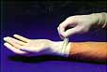
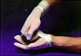

Personal Protective Equipment (PPE)
Always remove gloves before exiting the laboratory and dispose of them as hazardous waste, if applicable
Remember, PPE is the last line of defense for your safety protection
Do not touch mouth, eyes or face while handling materials
Proper Glove removal technique
1. Take hold of the first glove at the wrist.
2. Fold it over and peel it back, turning it inside out as it goes. Once the glove is off, hold it with your gloved hand.
3. To remove the other glove, place your bare fingers inside the cuff without touching the glove exterior. Peel the glove off from the inside, turning it inside out as it goes.
40

Slide 41
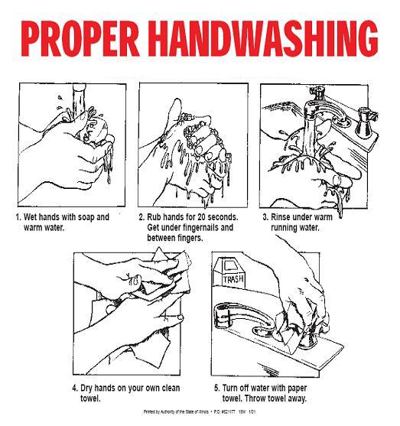
General Operational Practices
Hands must be washed:
after gloves have been removed
before leaving the laboratory
after handling materials known/suspected to be contaminated
41

Slide 42
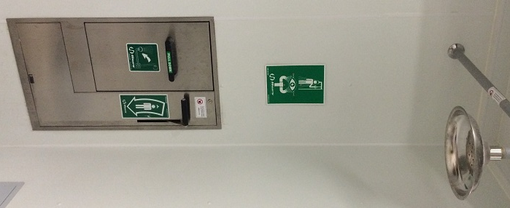
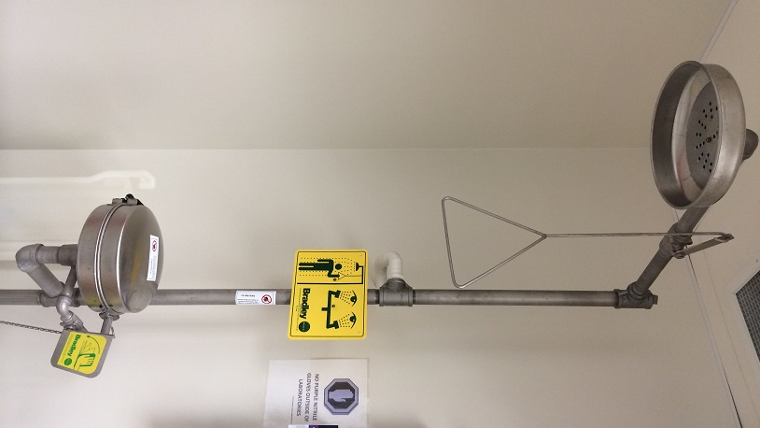
Emergency Equipment
Emergency showers are available in all CLS laboratories. Two shower designs are used at the CLS:
To activate shower
pull handle
42

Slide 43
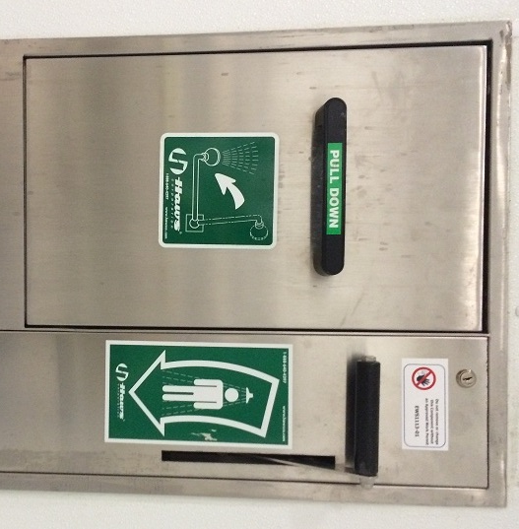
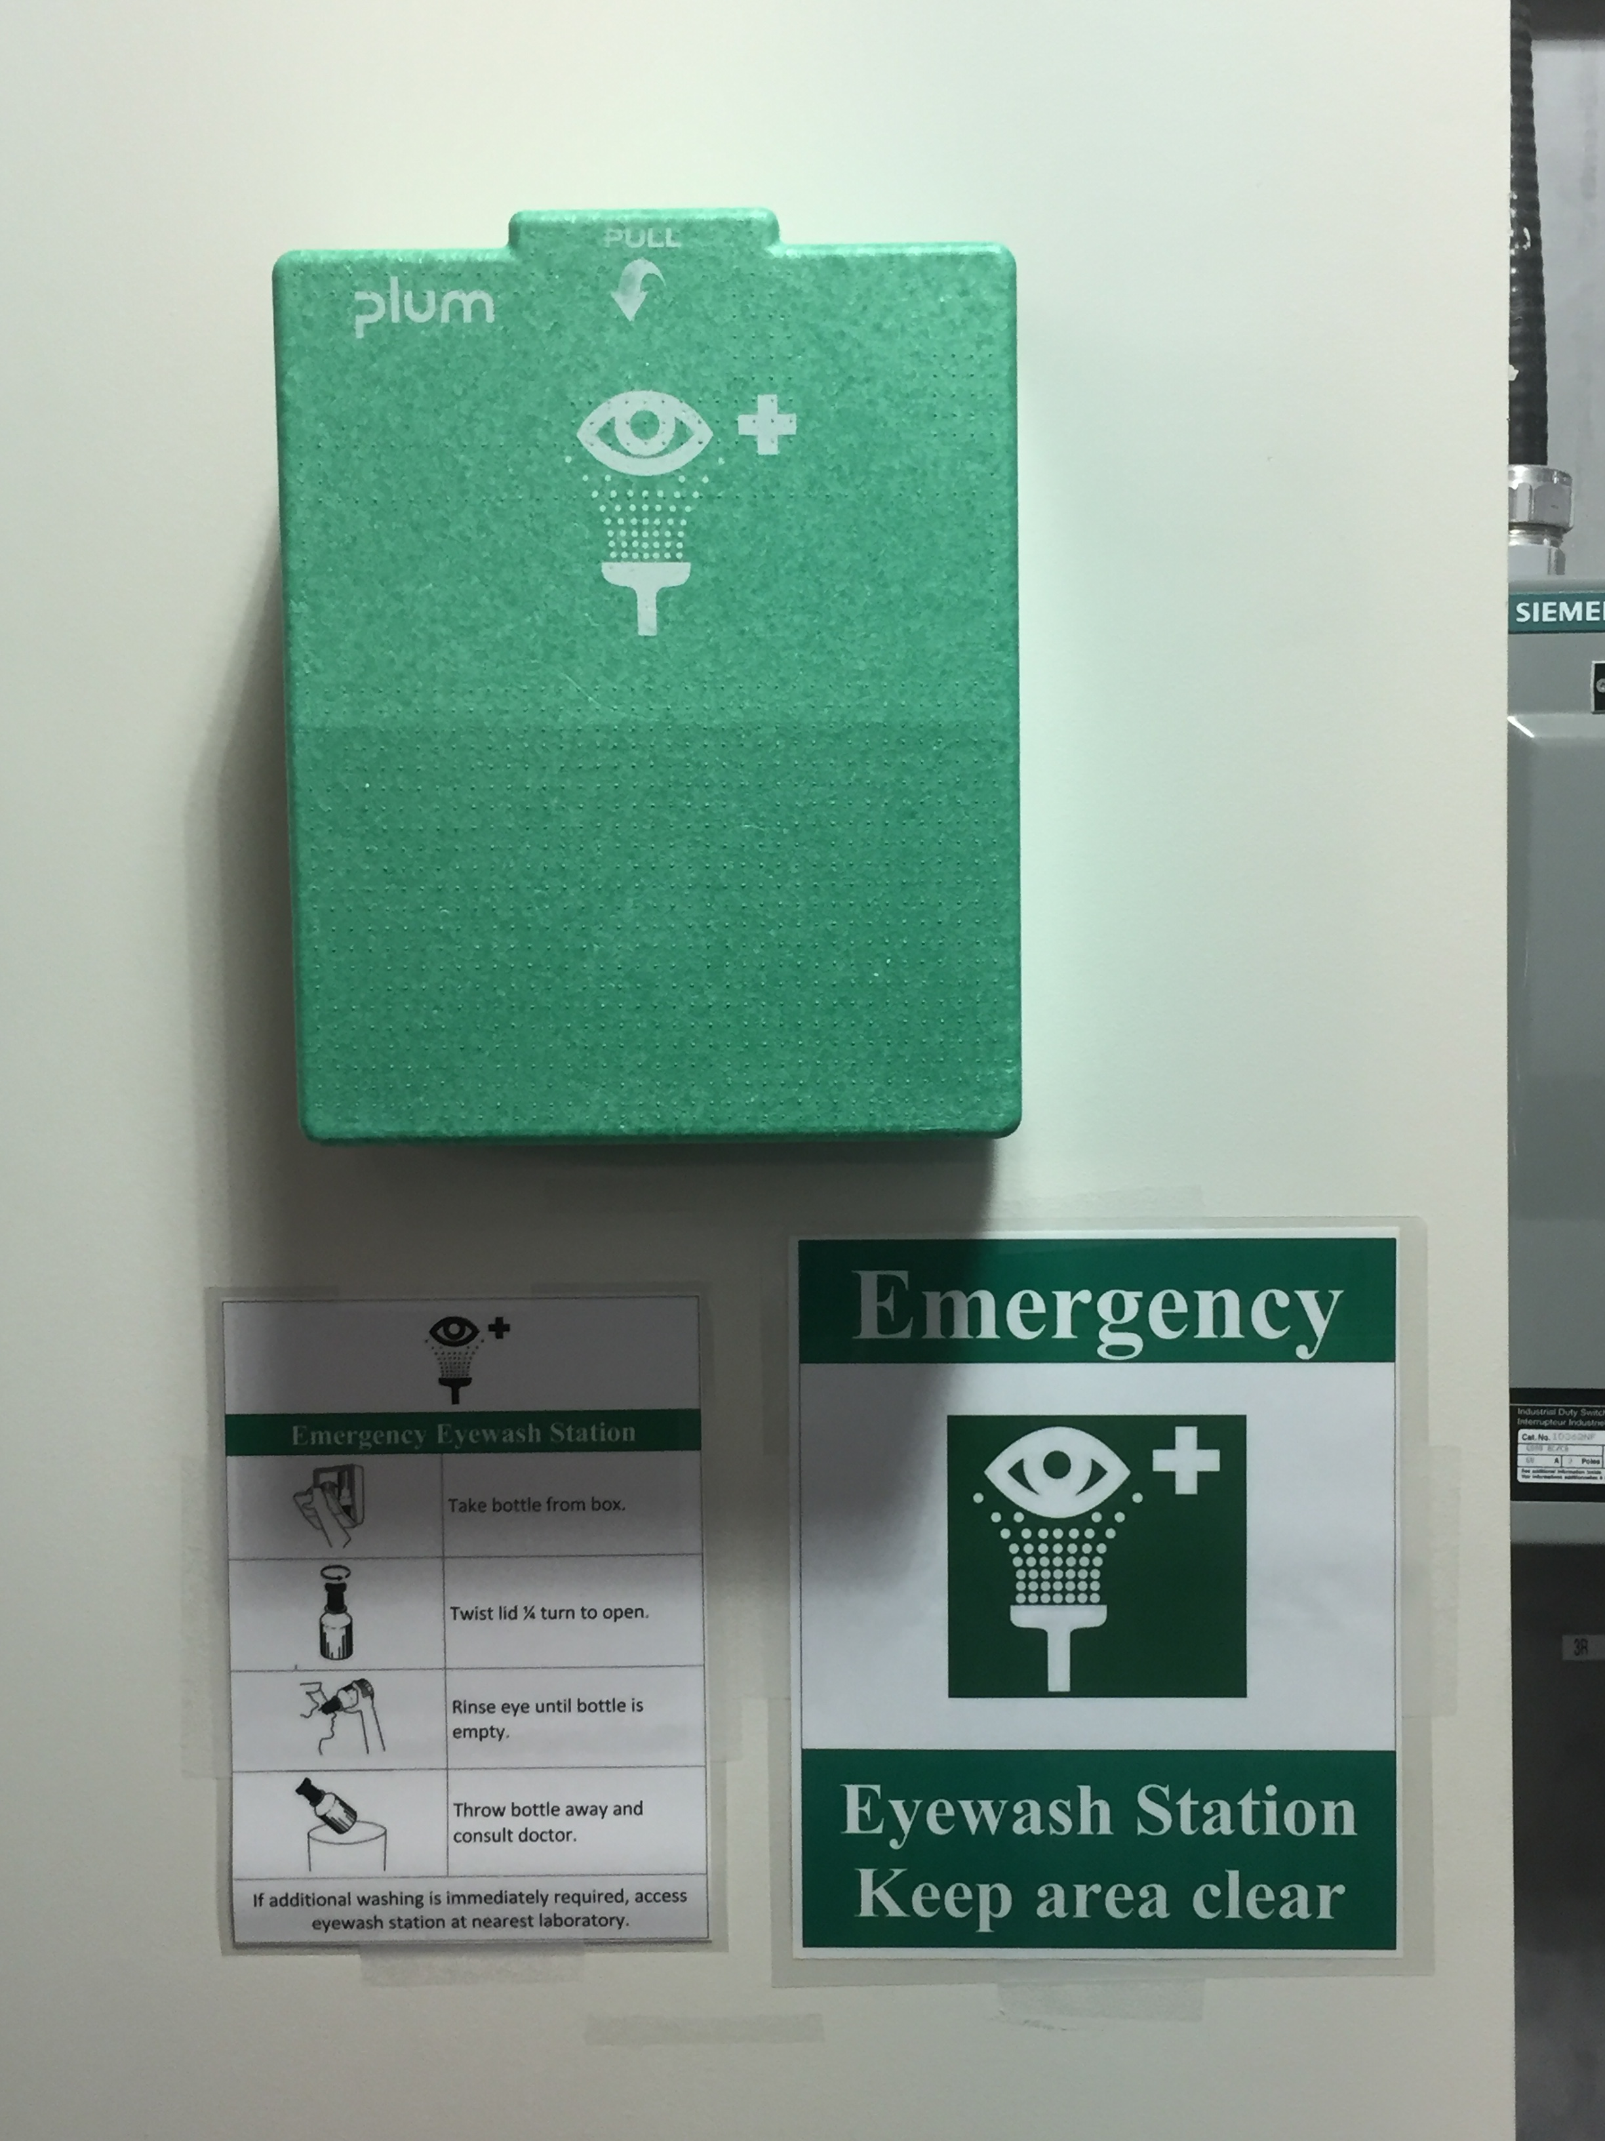
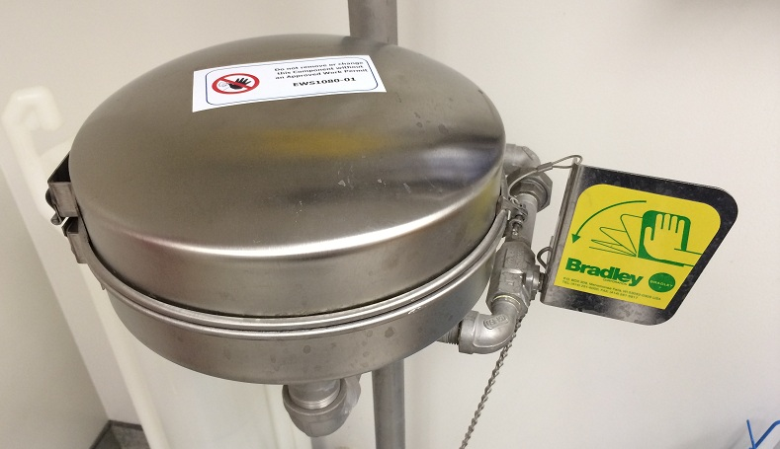
Emergency Equipment
Eyewash stations are available in all laboratories and in several other locations. Three eyewash designs are used at the CLS:
To activate eyewash: pull handle/push handle
43

Slide 44
You have completed the review of safety information and should be ready to take your multiple choice test. It is open book. You need to correctly answer 80% of the questions.
Good Luck!
If you pass, you will be granted supervised access to appropriate controlled areas related to your education program. If you are working on a beamline, you will receive an orientation specific to that area when you arrive.
You are allowed 3 attempts to pass. If you are not successful, ask your teacher to contact the CLS User Services for assistance (clsuso@lightsource.ca or 306-657-3700). They will be able to help you during regular business hours in Saskatoon.
44

